Slide 1
Dijkstra’s Algorithm

Slide 2
Dijkstra’s Algorithm
Is used to find the shortest path between a vertex and every other vertex.
Works for weighted graph.
Doesn’t work for graphs with negative weights.

Slide 3
Cont’d
Steps:
Set the distance of all the vertices infinity except for the starting vertex
Set the distance of the starting vertex zero
At each vertex:
Mark the current vertex as visited
Update the distance of the second vertices connected to the current vertex
Decide the next vertex to be evaluated
After all the vertices have been visited, take the value of the distance on the second vertex. The shortest path will be the one leading to this value

Slide 4
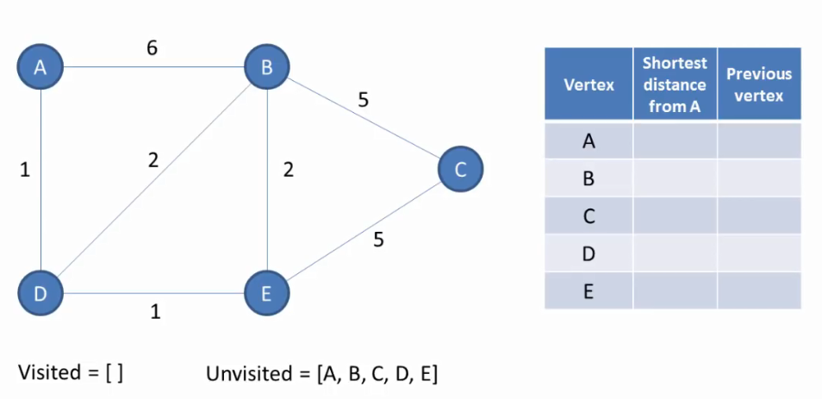

Slide 5
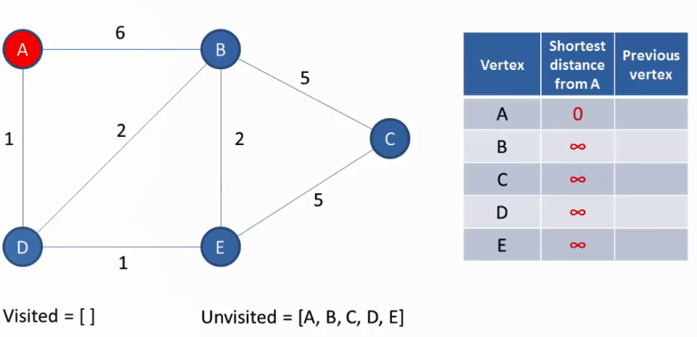

Slide 6
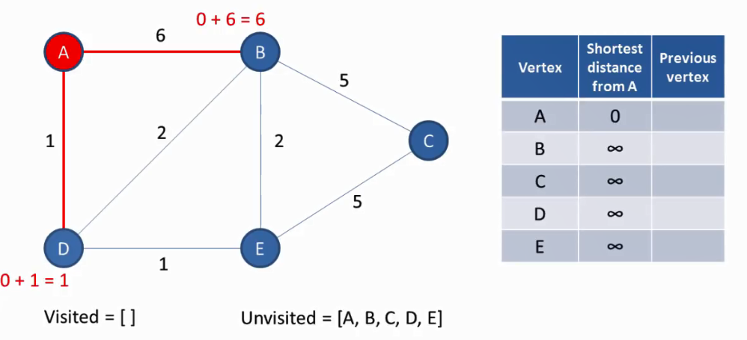

Slide 7
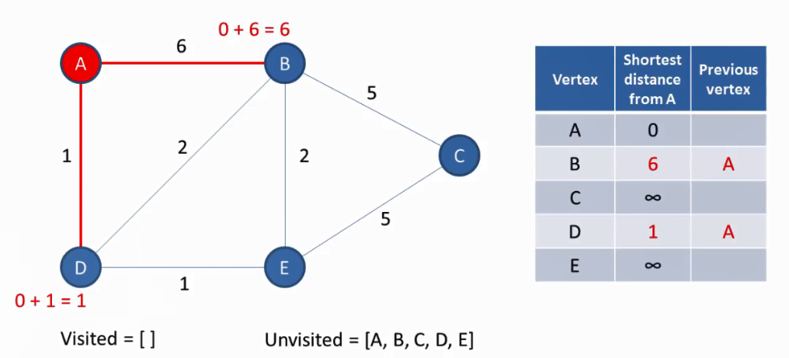

Slide 8
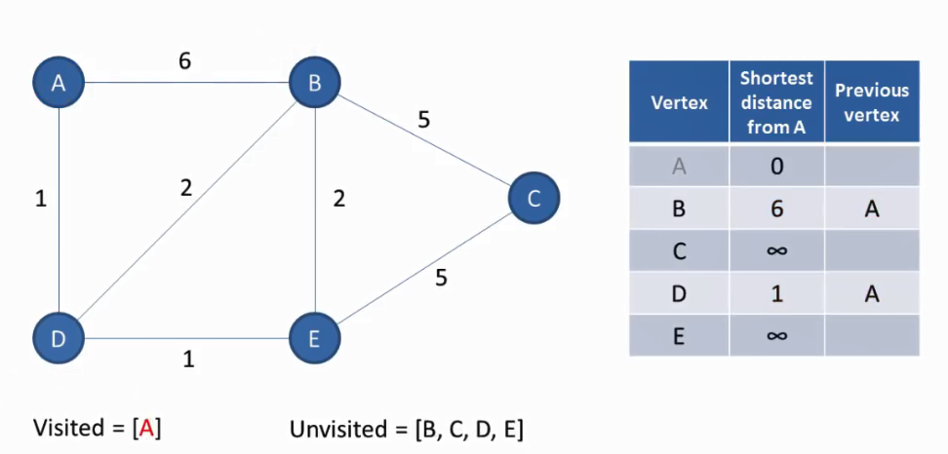

Slide 9
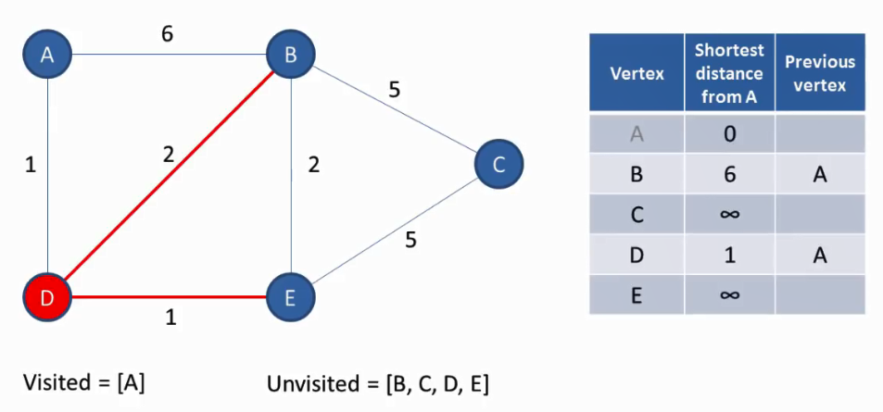

Slide 10
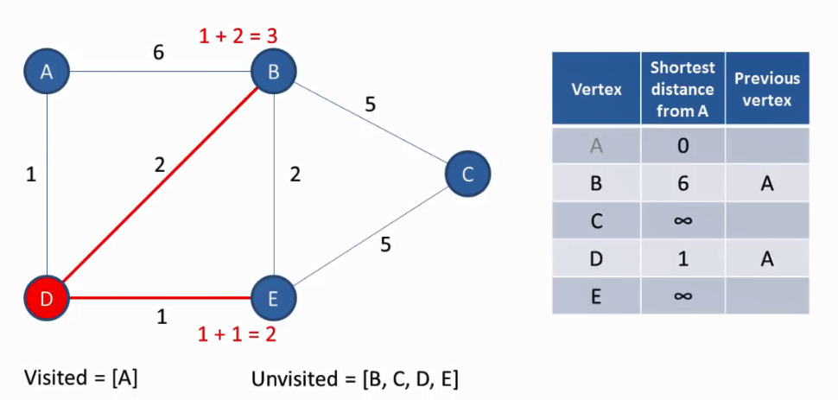

Slide 11
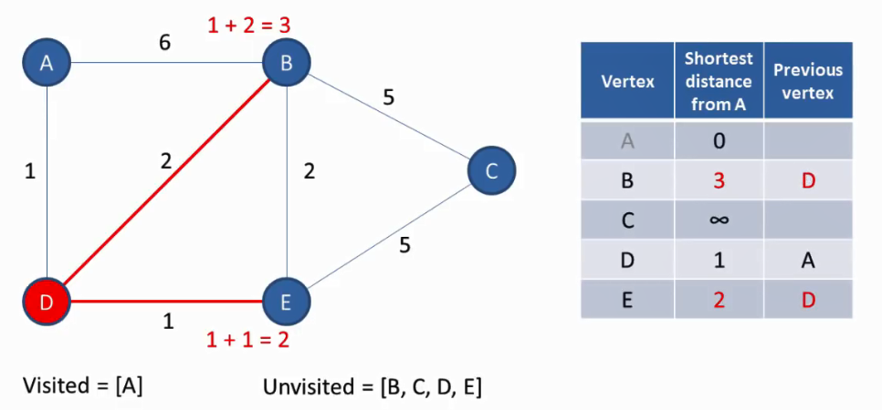

Slide 12
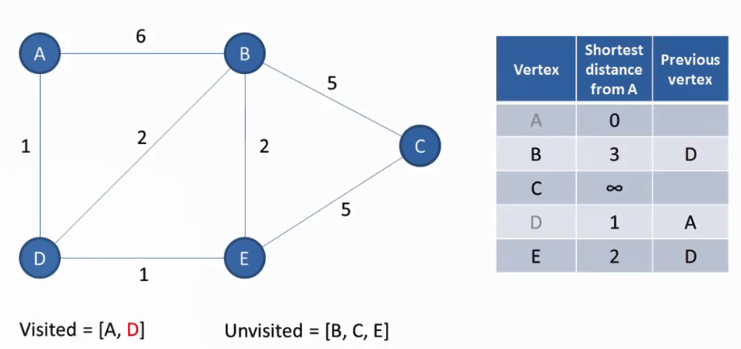

Slide 13
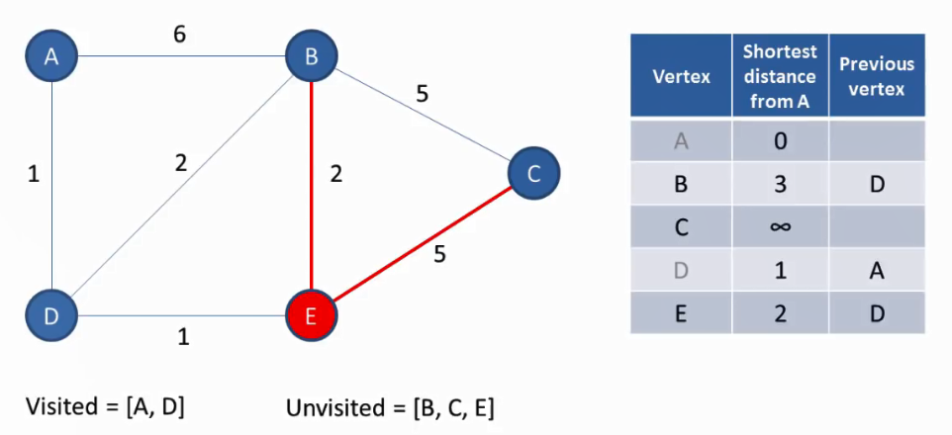

Slide 14
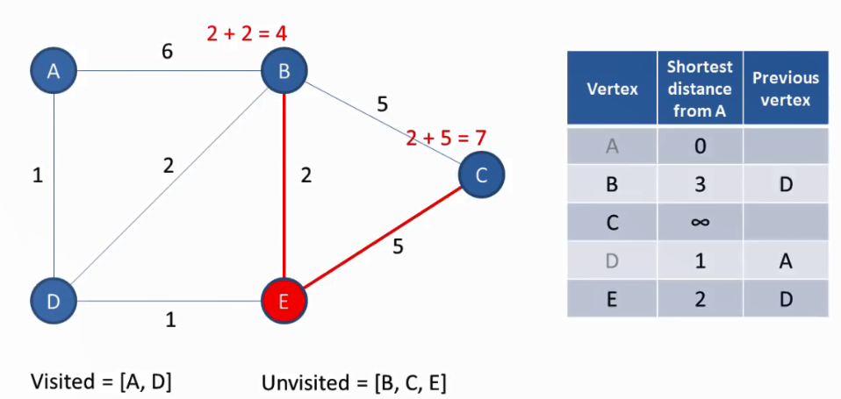

Slide 15
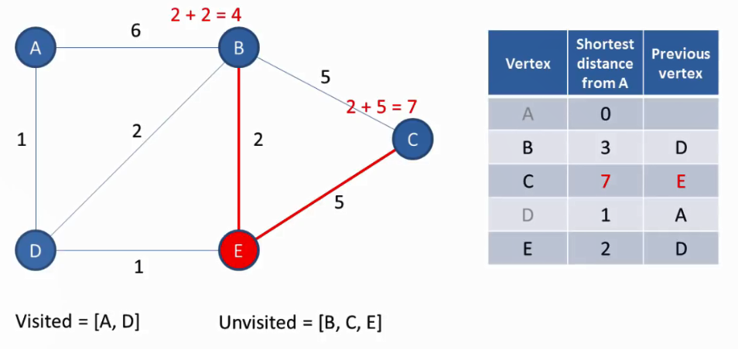

Slide 16
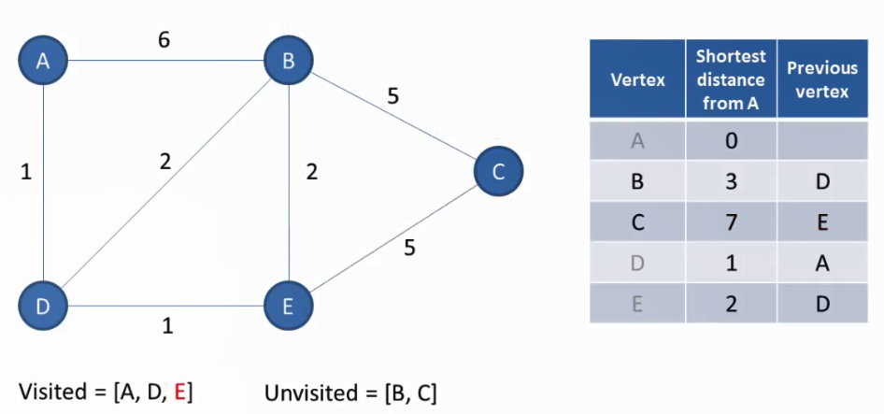

Slide 17
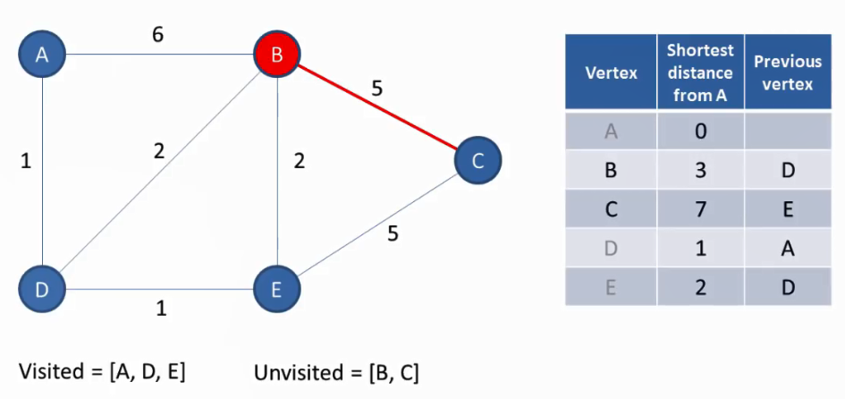

Slide 18
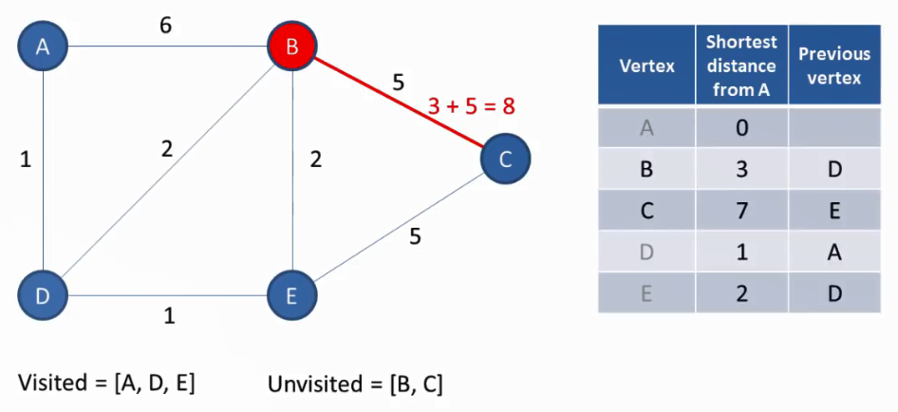

Slide 19
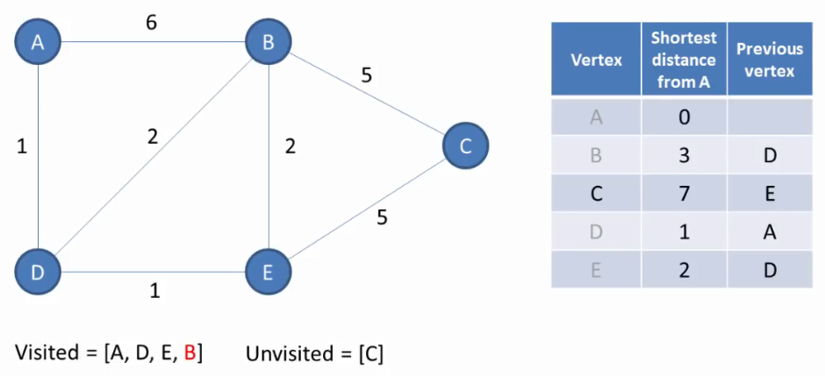

Slide 20
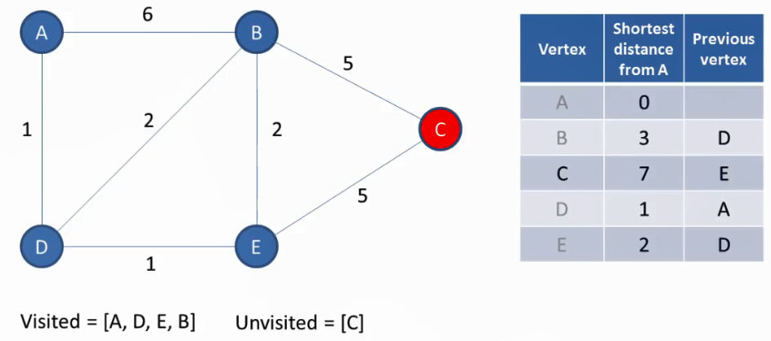

Slide 21
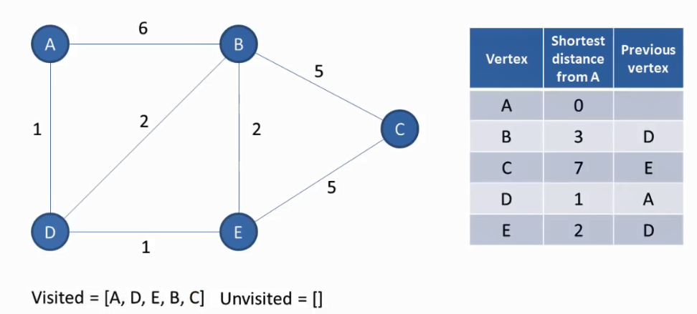

Slide 22
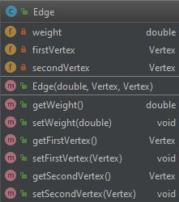
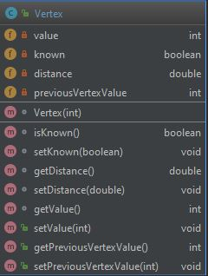
Implementation
Model classes

Slide 23
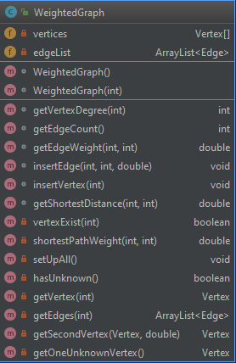
Cont’d
Holds array of vertex and ArrayList of Edge
Overloaded Constructor
Takes the size of the array or a default value of 50
The getShortestDistance() method calls the shortestPathWeight() which implements Dijkstra’s Algorithm.

Slide 24
shortestPathWeight()
public void shortestPathWeight(int value) { setUpAll(); getVertex(value).setDistance(0); getVertex(value).setPreviousVertexValue(value); Vertex currentVertex = getVertex(value); while (hasUnknown()) { if (currentVertex == null) currentVertex = getOneUnknownVertex(); ArrayList<Edge> edges = getEdges(currentVertex.getValue()); currentVertex.setKnown(true); double nextPathDistance = Double.MAX_VALUE; for (Edge edge : edges) { if (edge.getSecondVertex().getDistance() > currentVertex.getDistance() + edge.getWeight()) { edge.getSecondVertex().setDistance(currentVertex.getDistance() + edge.getWeight()); edge.getSecondVertex().setPreviousVertexValue(currentVertex.getValue()); } if (edge.getWeight() < nextPathDistance) { nextPathDistance = edge.getWeight(); } } currentVertex = getSecondVertex(currentVertex, nextPathDistance); } }

Slide 25
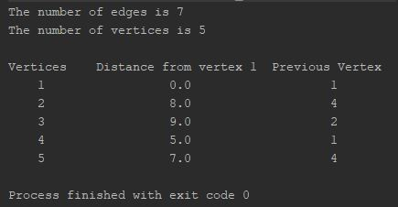
Output

Slide 26
THANK YOU

